Slide 1

Hospital Management System: Architecture and Features

Slide 2
Patient Management
Dynamic Patient List
Patient Class
The system utilizes a linked list to manage patient data, enabling efficient addition, deletion, and searching of records.
The Patient class represents a single patient and includes attributes like ID, name, age, disease, phone number, assigned doctor, and bed number. Each Patient object acts as a node in the linked list.

Slide 3
Hospital Facility Management
Graph Representation
HospitalGraph Class
The hospital layout is modeled as a weighted graph, where facilities are nodes and distances between them are edges.
The HospitalGraph class stores facilities and their connections using an adjacency matrix. It provides functionalities to calculate shortest paths using Dijkstra's algorithm.

Slide 4

Bed Management
Bed Allocation
Bed Status
A boolean array effectively tracks the availability of beds, ensuring patients are assigned to unoccupied ones.
The system allows for the release of beds upon patient discharge, ensuring their availability for new admissions.
Hospital Class
The Hospital class manages bed availability, patient assignments, and other key functionalities within the hospital.

Slide 5



Emergency Management
Priority Queue
1
The system uses a min-heap to prioritize emergency patients based on severity.
Emergency Priority
2
Receptionists can assign an emergency priority level to patients, with lower numbers indicating higher urgency.
Emergency Patients
3
The min-heap ensures that patients with the highest priority (lowest number) are attended to first.

Slide 6




Doctor Management
Doctor Class
Doctor Details
The Doctor class stores information about each doctor, including ID, name, age, and phone number.
The system allows the addition or update of doctor details and provides functionalities to display registered doctors.
Doctor Assignments
Patients are assigned to doctors, and doctors can view their assigned patients.

Slide 7

User Role-Based Access
Owner Menu
Doctor Menu
Provides access to functions for managing doctors, viewing patient details, and checking bed availability.
Enables doctors to view their patients, search for patients by ID or name, and manage other doctor-specific functions.
Receptionist Menu
Patient Menu
Offers functionalities for adding new patients, assigning emergency priority, and viewing emergency patients.
Allows patients to access their details by entering their ID.

Slide 8


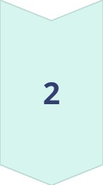
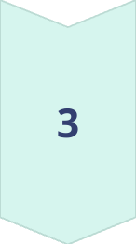
System Advantages
Modularity
The use of separate classes like Patient, Doctor, HospitalGraph, and Hospital promotes modularity and code reusability.
Scalability
The system can be easily extended to handle larger hospitals due to its efficient use of data structures like linked lists, graphs, and heaps.
Real-World Modeling
The system accurately reflects key aspects of hospital management, including patient tracking, bed allocation, and emergency prioritization.

Slide 9
System Limitations
Hard-Coded Limits
1
The system currently has hard-coded limits on the number of doctors (4), facilities (5), and beds (20).
Concurrency
2
The system does not handle concurrent modifications, which could lead to inconsistencies in a real-world scenario with multiple users.
Input Validation
3
Input validation could be improved to handle invalid inputs more gracefully and ensure data integrity.

Slide 10

Future Improvements
1
2
Dynamic Memory Allocation
Concurrency Handling
Replace fixed-size arrays with dynamic memory allocation to handle an unlimited number of doctors, facilities, and beds.
Implement mechanisms to handle concurrent modifications and ensure data consistency.
3
4
User Interface
Data Persistence
Develop a user-friendly graphical interface for ease of use and intuitive navigation.
Implement a database or file system to store data persistently and ensure data is retained between sessions.

Slide 11
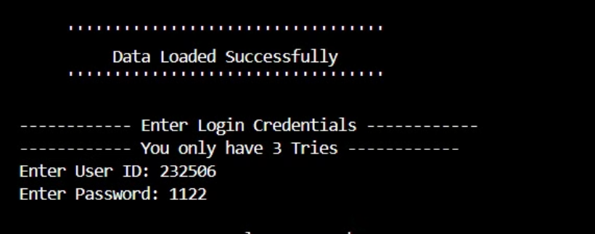
Login Menu

Slide 12
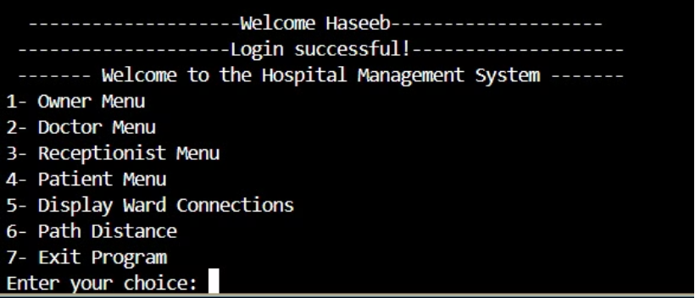
Main Menu

Slide 13
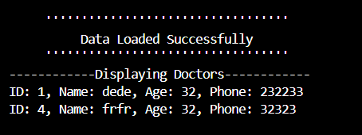
View Doctors

Slide 14
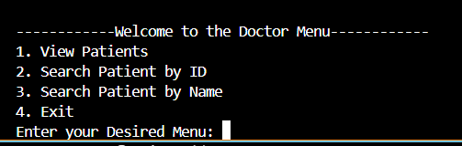
Doctor Menu

Slide 15
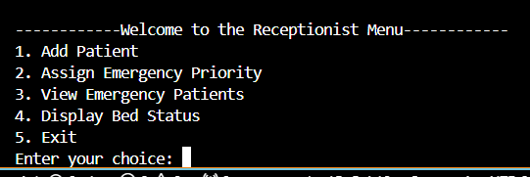
Receptionist Menu

Slide 16
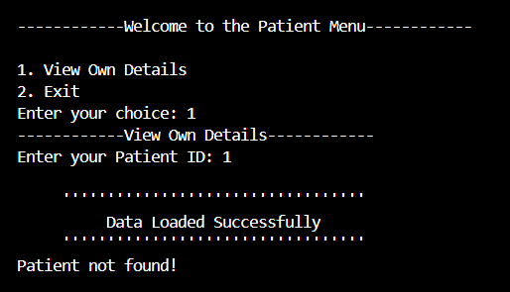
Patient Menu

Slide 17
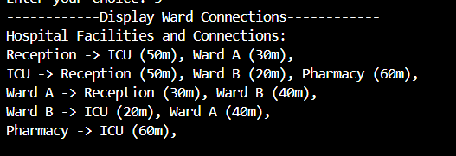
Ward Connections

Slide 18
Ward Connections

